Slide 1
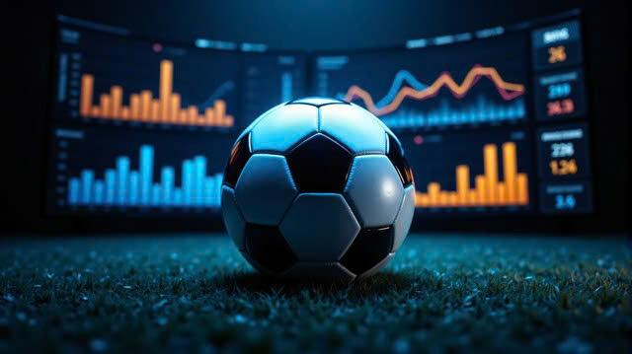
DECODING MODERN FOOTBALL
Tactics, Talent and Transfer Value

Slide 2
DECODING MODERN FOOTBALL
Tactics, Talent and Transfer Value
🎓 Graduation Project – Data Analysis on EA Sports FIFA & Transfermarkt
Presented by: Hoang Bui
Research time: 2015 - 2023
Date: May 24th, 2025

Slide 3
🔹 Project Introdution
✨ Why This Project?
Football is called “the king game” for a reason — but in today’s era, it’s also becoming a smart game.
⚽ Context
Football has evolved with data and technology shaping every aspect of the sport.
Analytics now supports players, coaches, and clubs in making better decisions.
📊 What This Project Does
This project uses longitudinal data from FIFA 15–23 to:
Track tactical evolution over time
Identify the key attributes of top players
Evaluate the real vs predicted market values

Slide 4
🔍 Purpose & Research Questions
🎯 Purpose
To analyze the evolution of modern football using in-game data from EA SPORTS FIFA (FIFA 15–23) and Transfermarkt.
Focus on:
Tactical trends across positions
Key attributes that define great players
Data-driven understanding of market valuation logic
❓ Key Questions
Which position has evolved the most in modern football?
What player attributes have changed significantly over time by role/position?
What are the core attributes that make a great player in each position?
Which factors have the greatest influence on a player's market value?
How can we detect if a player is overrated or underrated?

Slide 5
🔹 Data Sources & Limitations
📁 Data Sources
FIFA 23 (EA SPORTS)
In-game player attributes (technical, mental, physical, etc.)
EA-estimated player value: value_eur
Transfermarkt
Real-world player valuations: market_value_in_eur
Metadata: nationality, club, position, etc.
⚠️ Key Limitations
Lack of Full Match Stats
Positional Ambiguity
Valuation Discrepancy
Timing Mismatch
Join Key Challenges
Duplicate Valuations

Slide 6
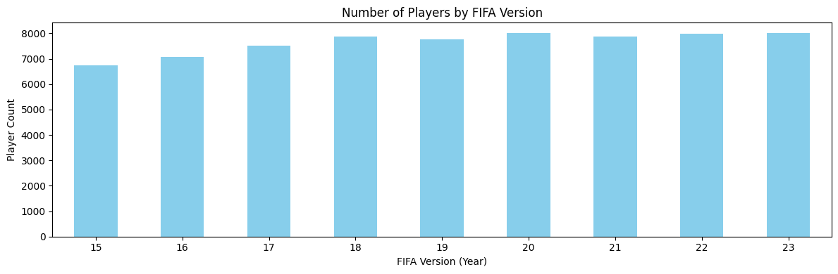
🔍 EXPLORATORY DATA ANALYSIS
📊 Key Insight
The number of players with complete attribute data is consistent across versions (~6,800 - 8,000)
The dataset is balanced → no year dominates the analysis
Provides a stable foundation for reliable time-series comparisons
📌 This consistency validates the dataset's structure and supports longitudinal trend analysis across FIFA versions.

Slide 7
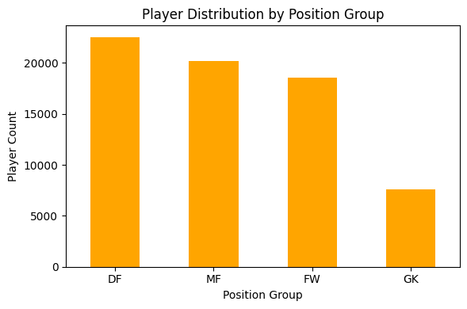
🔍 EXPLORATORY DATA ANALYSIS
📊 Key Observations
🛡️ Defenders (DF): largest group → diverse defensive roles
🧠 Midfielders (MF) & 🎯 Forwards (FW): balanced and well-represented
🧤 Goalkeepers (GK): ~7,000 → smallest group, as expected
✅ Why It Matters
Balanced dataset allows for robust position-based analysis
Sufficient player count for each role ensures model reliability
⚽ Fun Insight
Based on player counts, the most reflected formation is 4-3-3 — 4 Defenders – 3 Midfielders – 3 Forwards. Quite telling, isn’t it?

Slide 8
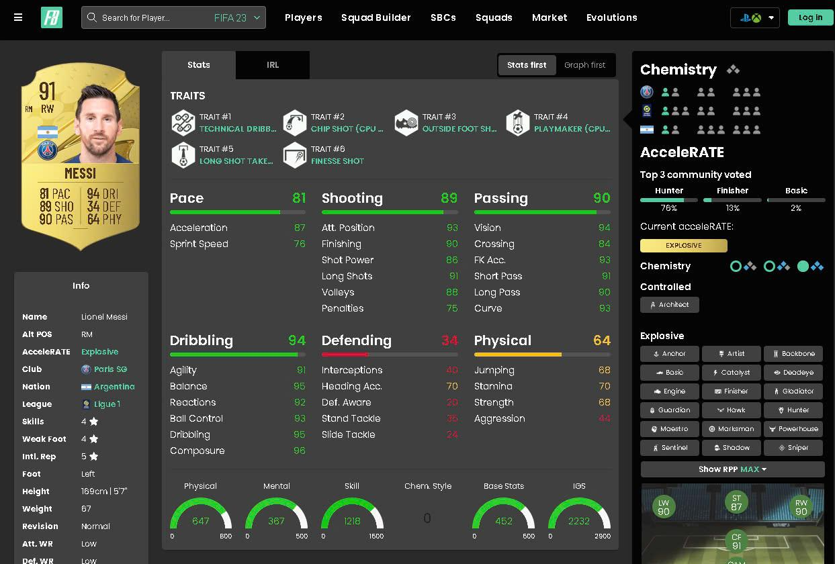
🔍 EXPLORATORY DATA ANALYSIS
📐 EA’s Attribute Structure
According to EA Sports, overall rating is computed as an average of main attributes, which themselves are averaged from detailed attributes.
➡️ Therefore, we focus our EDA at the main attribute level, then drill down into detailed metrics when needed.

Slide 9
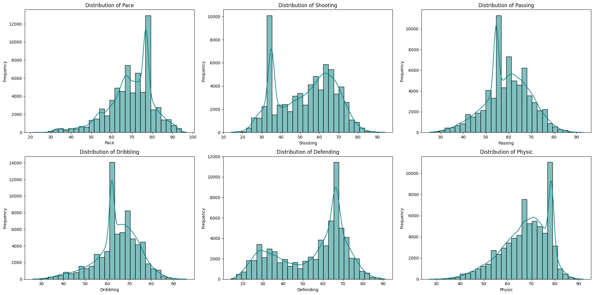
🔹Distribution of main attributes
📌 Attribute distributions reflect role specialization in football: Attackers and defenders show clear separation in stats like defending, while core traits like dribbling and passing are more balanced.

Slide 10
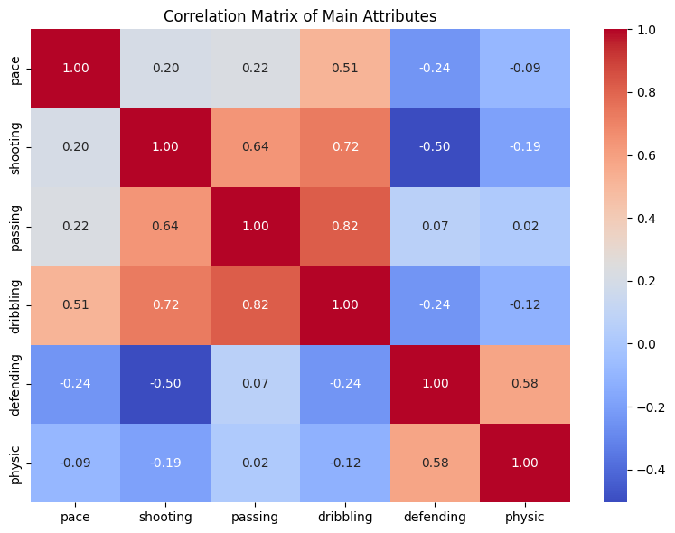
🔹 Correlation matrix of Main Attributes
📊 Key Observations:
Passing – Dribbling: 0.82 → Strong link among playmakers (CAM, CM)
Shooting – Dribbling: 0.72 → Common in technical attackers
Shooting – Defending: -0.50 → Strikers rarely excel in defense
Defending – Physic: 0.58 → Strong physical traits in defenders (CB, CDM)
Pace – Dribbling: 0.51 → Typical of fast wingers
🧠 Insight
Players tend to cluster into two groups:
Attacking-Technical: Dribbling, Passing, Shooting, Pace
Defensive-Physical: Defending, Physic

Slide 11
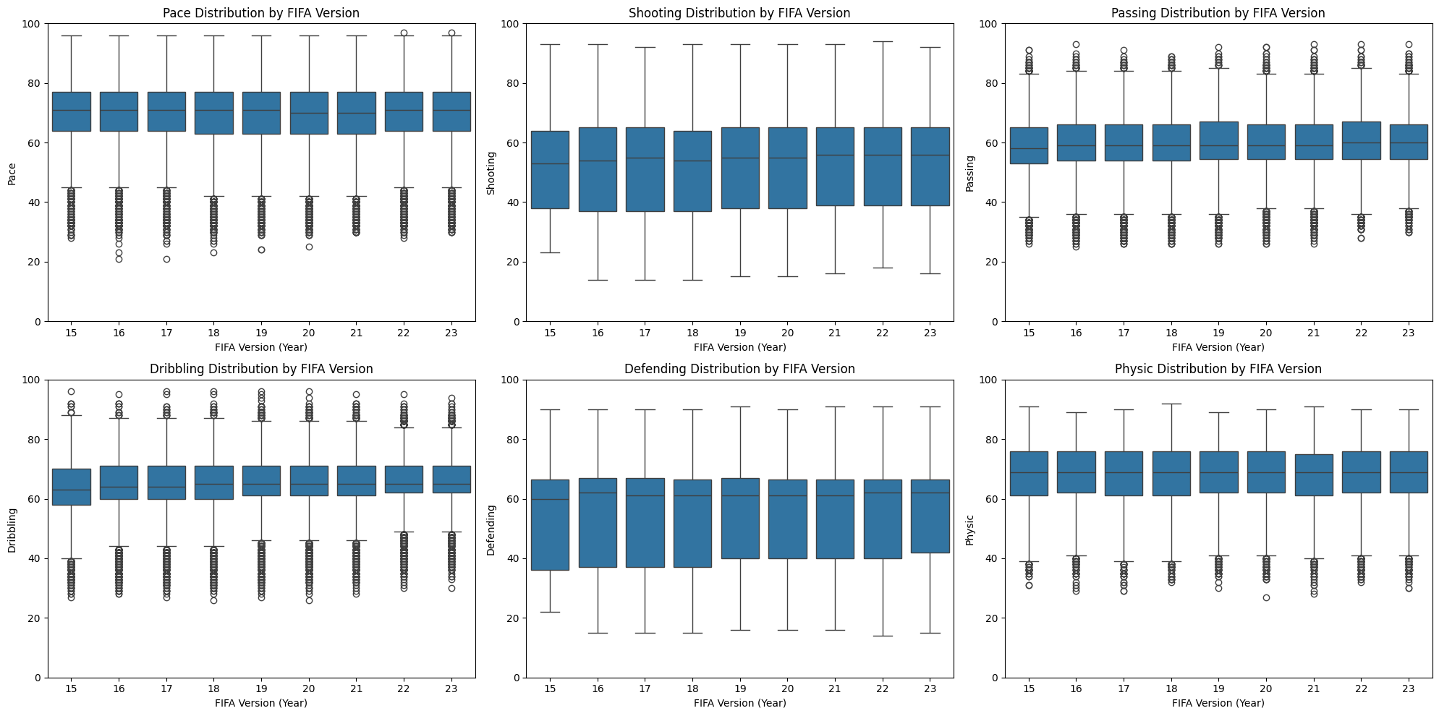
🔹Distribution of main attributes
The dataset is well-structured, stable over time, and clearly stratified — suitable for modeling without major cleaning.

Slide 12
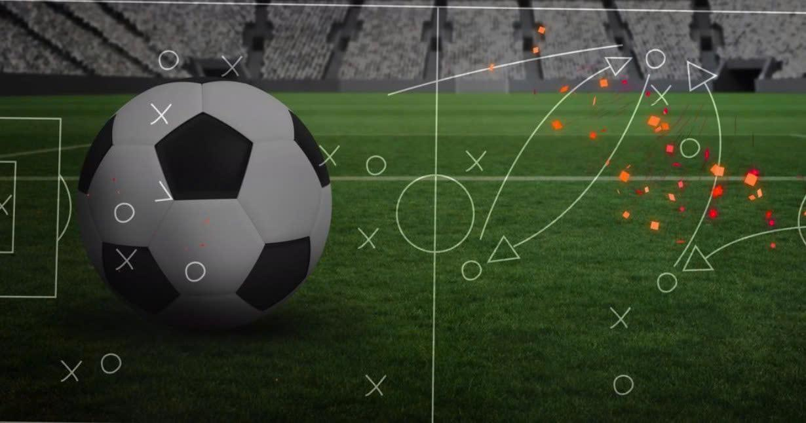
Part 1 - Tactical Shift Over Time

Slide 13
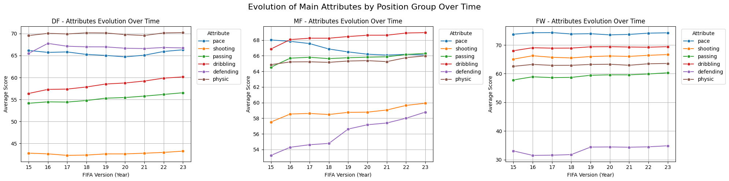
🔹 Which position has evolved the most in modern football?
🔁 Core Roles Remain, but Evolve
🧠 Midfielders: Defensive Attribute ↑ ➤ Reflects modern tactics (e.g. Gegenpressing, box-to-box roles), midfielders now contribute significantly to pressing & ball recovery
⚡ Pace Remains Critica: Stable across DF & FW → Needed for pressing, transitions, and recovery; Slight decline in MF → Emphasis on tempo control over speed
🔄 Slight Shift Toward Versatility: Small increases in non-core traits, implies modern players are more well-rounded
🧩 Core Strengths Still Dominate: Despite tactical shifts, top scores remain in role-specific attributes. Positional specialization remains essential to success
📌 The biggest tactical reflection in FIFA data is the increased defensive role of midfielders, alongside the enduring importance of pace and growing demand for versatility across all positions.

Slide 14
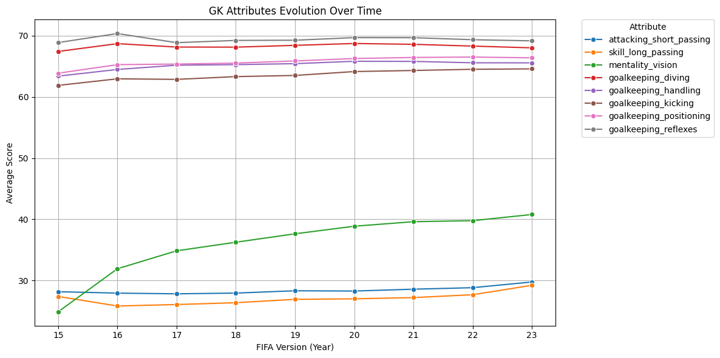
🔹 Tactical Change in Playing Style
Modern goalkeepers must be good at both technical skills and coordination, becoming the "first initiator of attack".

Slide 15
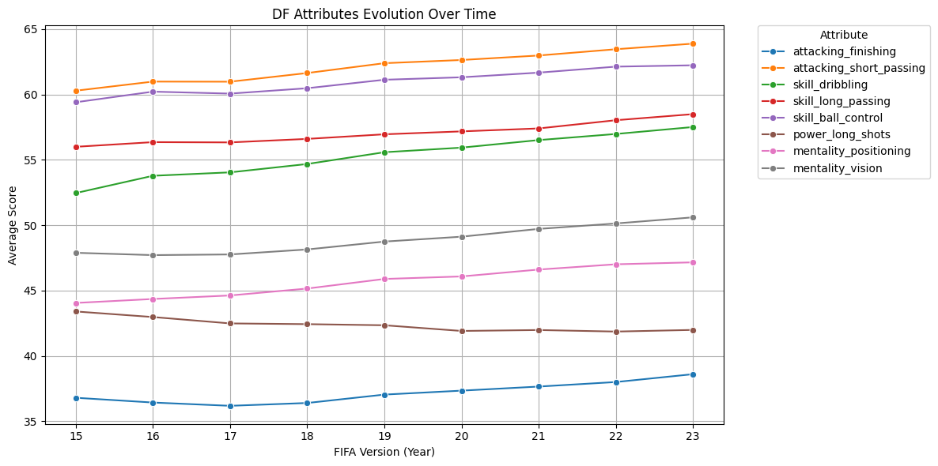
🔹 Tactical Change in Playing Style
The trend of ball-playing defenders is becoming more and more obvious, they not only defend but also participate in build-up play, distributing the ball from the back line.

Slide 16
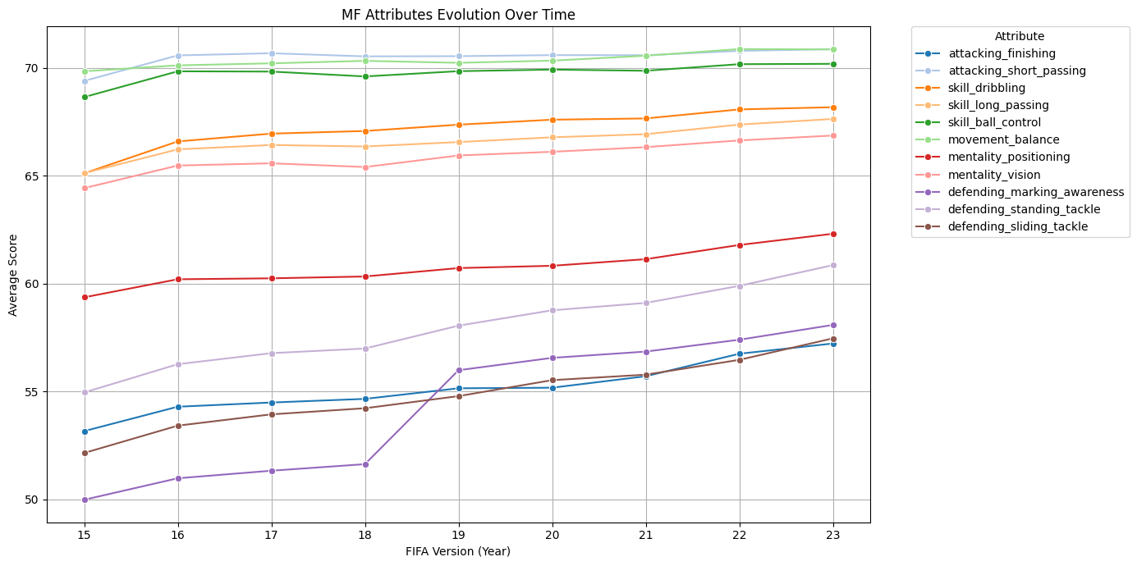
🔹 Tactical Change in Playing Style
Shows the emergence of complete midfielders – both offensive and defensive, and controlling the tempo of the match.

Slide 17
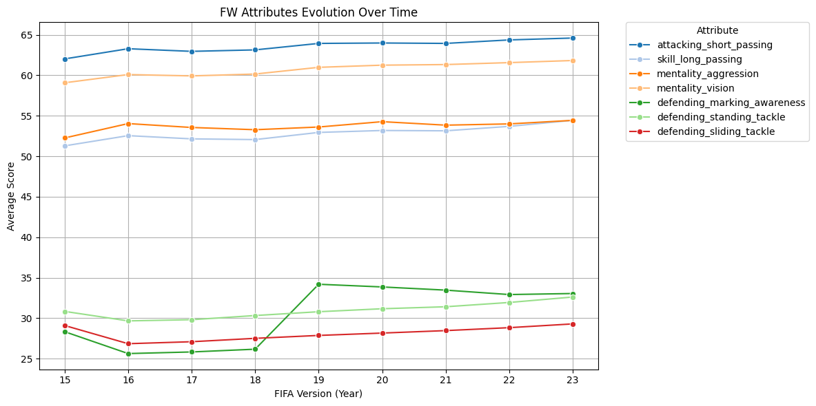
🔹 Tactical Change in Playing Style
Forwards in modern football are no longer "poachers" who just wait for the ball but are also the first link in the defensive system.

Slide 18
🔹 Tactical Evolution – Key Conclusion
📌 Conclusion
In modern football, every position has evolved to meet the demands of faster pace and more complex tactics.
However, the most revolutionary changes are seen in:
🧤 Goalkeepers (GK): From pure shot-stoppers to play initiators
🛡️ Defenders (especially Full-Backs): Now act as creators, runners, and pressers
➡️ These roles have expanded far beyond their traditional definitions, making them the symbol of tactical transformation in today’s game.

Slide 19
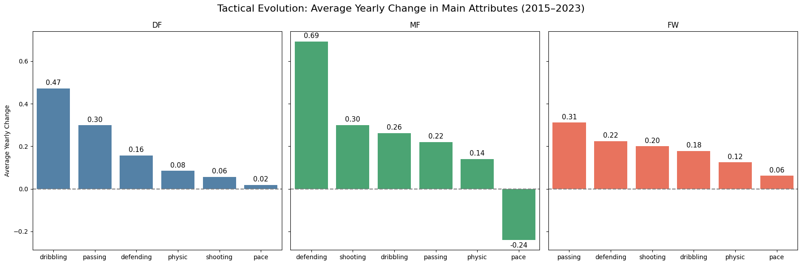
🔹 Key Attribute Changes by Position (2015–2023)
Modern defenders now help build from the back, not just clear the ball
Midfielders Reflects trend of box-to-box midfielders: organize play + intercept + press
Forwards now press from the front and support build-up, not just finish
Modern football favors movement, vision & positioning over raw speed (pace)
📌 Conclusion
Dribbling, Defending, and Passing have changed the most.
Modern football demands versatile players who contribute to team structure, not just shine in isolated roles.

Slide 20
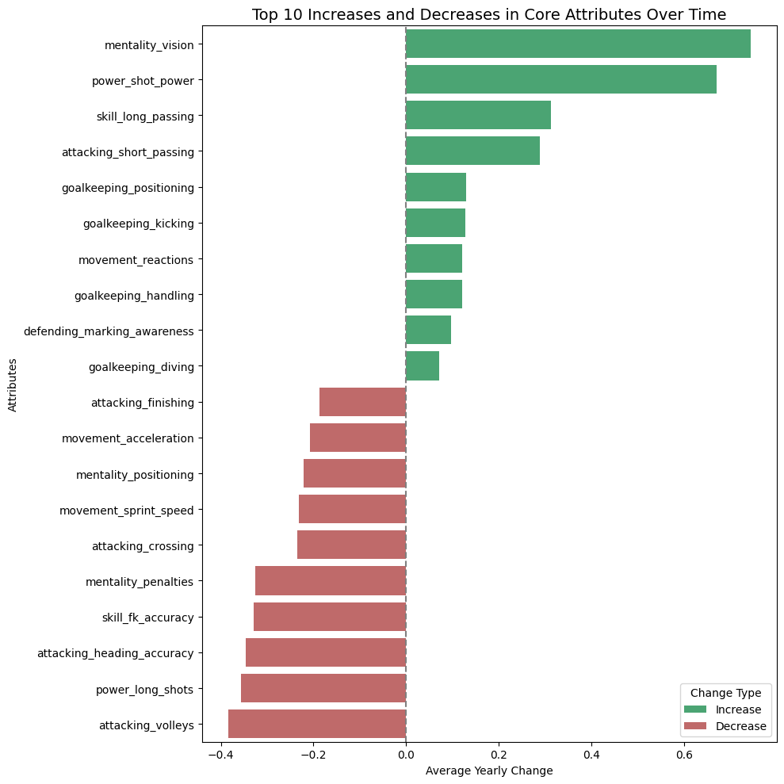
🔹 Tactical Shift in Modern Football (2015–2023)
➤ Direct scoring methods are fading — replaced by structured build-up ➤ Less reliance on aerial plays & wide crosses ➤ Move away from classic Anglo-Saxon styles ➤ Reflect pressing & positional play: build from the back, escape pressure, close down space ➤ Modern GKs are multi-functional: reflexes, positioning, playmaking, a save = a goal in high-level matches
📌 Conclusion
Football is evolving tactically
Modern players must be flexible, versatile, and system-oriented, not just masters of isolated roles.

Slide 21
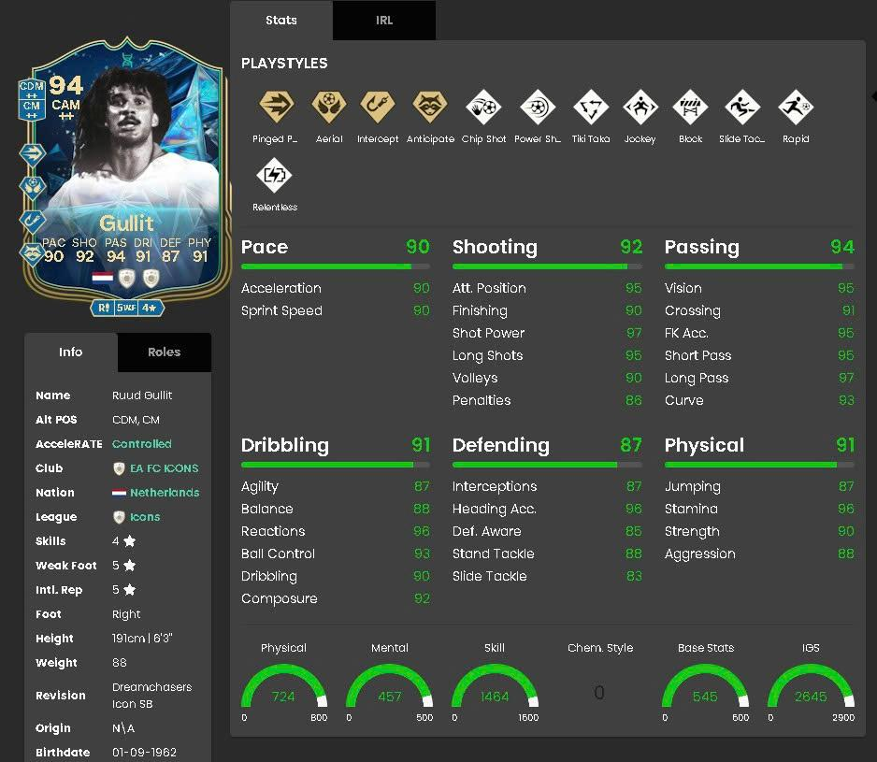
Part 2 – The Making of a Great Player
This study focuses on in-game attributes only, not real-life performance metrics.
WHO IS HE?

Slide 22
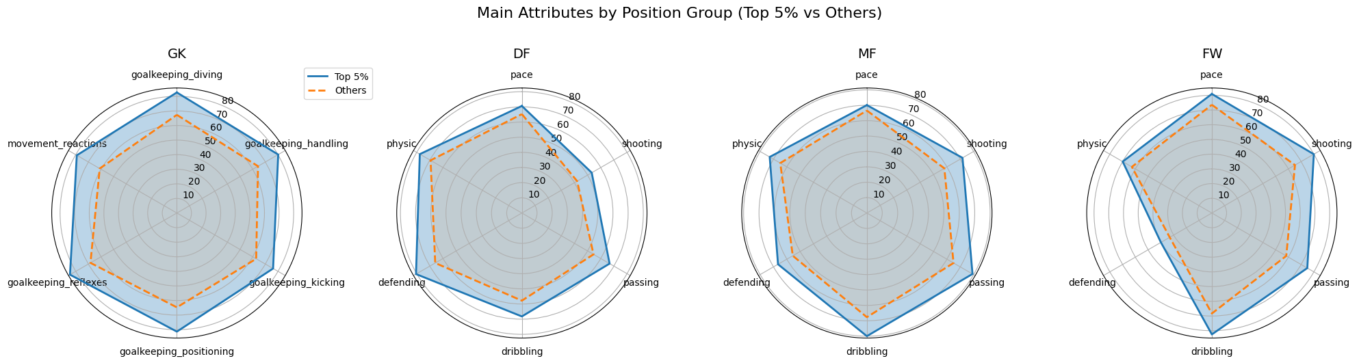
🔹 What main attributes make a great player?
🧤 A complete goalkeeper needs sharp reactions and positional mastery
🛡️ Excellent defenders initiate build-up, not just clear the ball
🧠 Great midfielder controls tempo, create & finish chances
🎯 Top forwards decide games with creativity & finishing ability
📌 Note: Radar charts highlight clear attribute separation between top 5% and another players in each role.

Slide 23
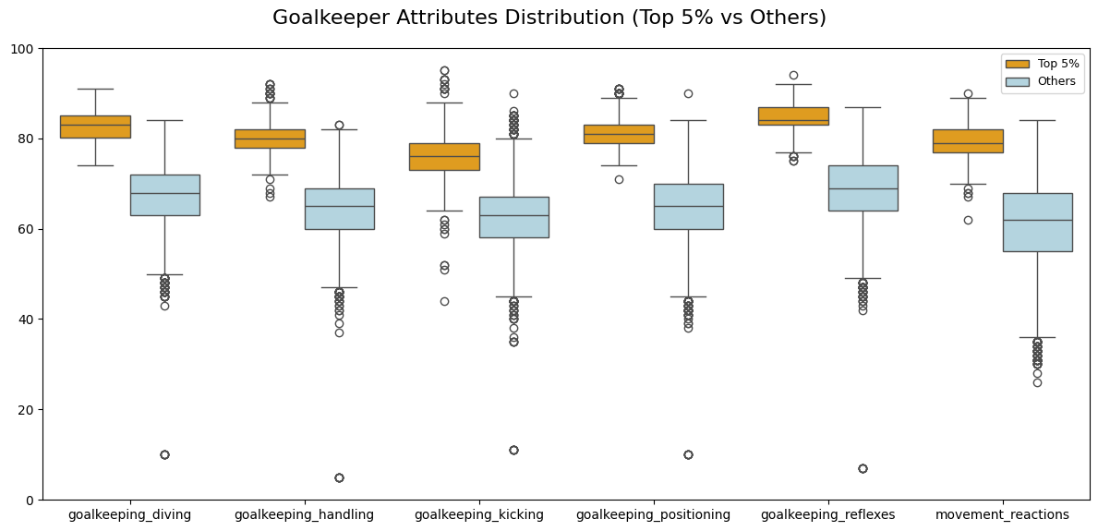
🔹 What Makes a Great Goalkeeper?
➤ Well-rounded skill set: Not just specialists — they’re consistently good across the board
➤ High consistency: Low variability , stable performance even under pressure
➤ Reflexes & Reactions are the most differentiating factors, these traits define legendary saves and split world-class GKs from the rest

Slide 24
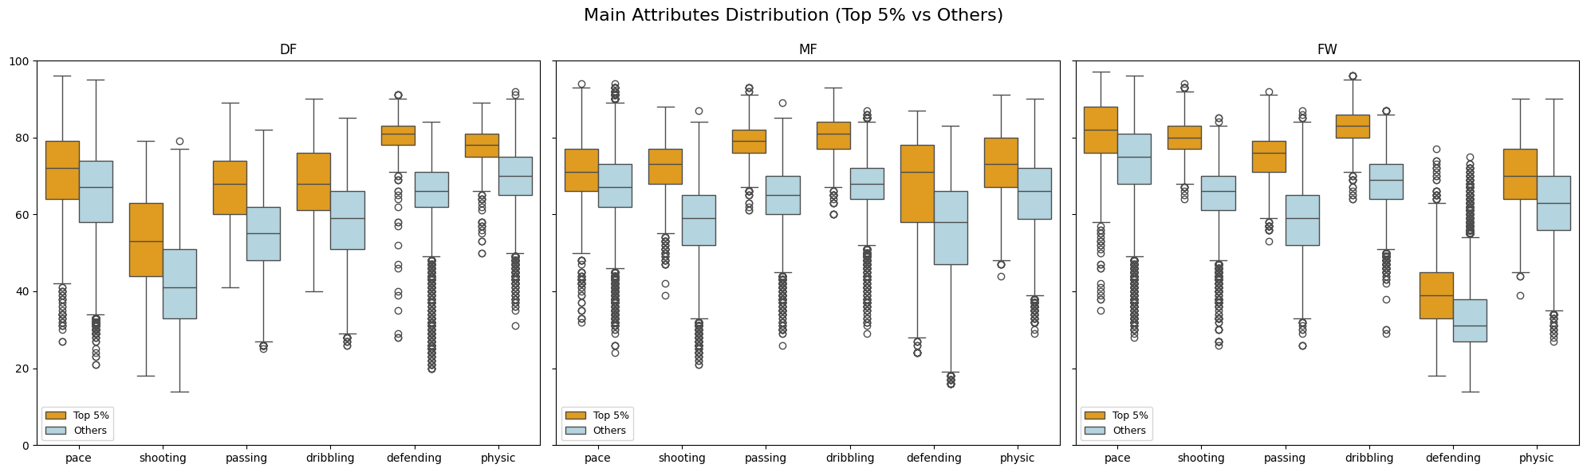
🔹 What Makes a Great Player?
🧠 Top 5% players outperform the rest in both skill level and consistency, more reliable performance. They’re well-rounded, not just strong in one stat
🛡️ Great defenders support both defense & build-up with technique
🎮 Great midfielders are versatile engines — assist, defend, and control match
🎯 Great forwards are not just scorers, but also skilled and fast
📌 Across all roles, top players combine excellence in core skills with consistency and versatility — the foundation of football greatness.

Slide 25
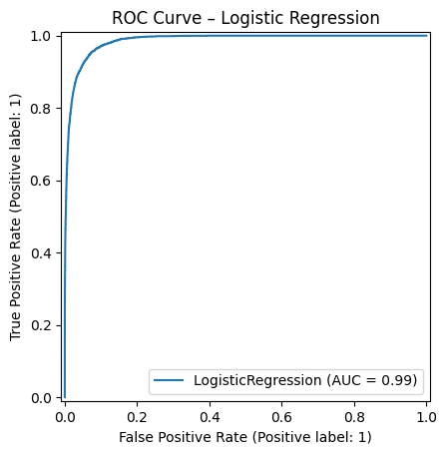
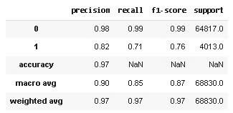
🔹 What core attributes make a great player?
Based on FIFA player attributes, what are the core features that distinguish top 5% players from the rest?
To analyze this we will use a logistic regression model to distinguish the great players (top 5%) from the rest.
After determining the core attributes, we will train the model and evaluate it based on the classification report and the ROC Curve graph.
✅ Logistic Regression Model Easy to understand, simple, shows very good efficiency in classifying "great players". Used to determine the core attributes that make a great player (via coefficients).

Slide 26
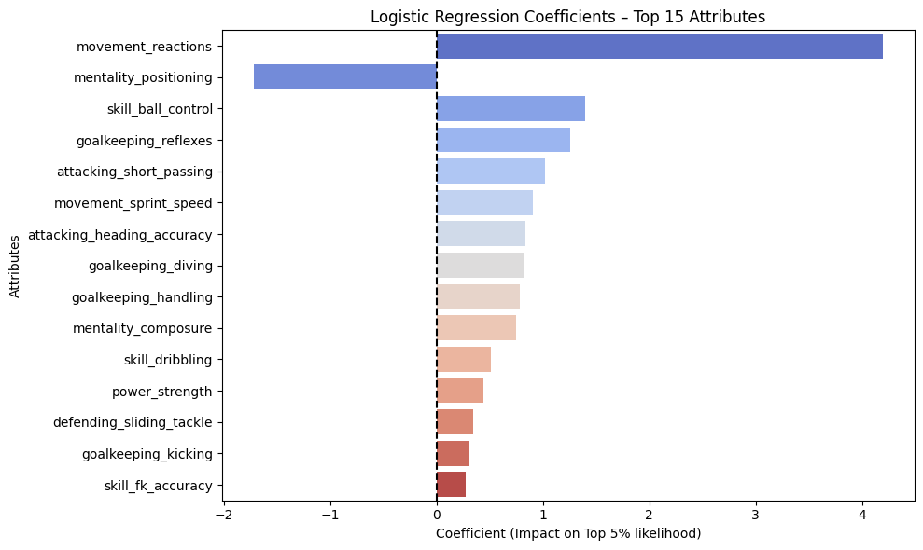
🔹 Core Attributes of a Great Player
💡 Top Contributing Attributes (by Model Coefficients):
⚡ Reactions: Fast reactions = decisive advantage in critical moments
🎯 Ball Control & Short Passing: Core skills for tight-space control & build-up play
🧠 Reflexes: Highlights presence of elite goalkeepers among top 5%
🏃‍♂️ Sprint Speed & Heading Accuracy: Common traits of top forwards
📉 Positioning:
➤ Negative coefficient may reflect role-specific distribution
➤ Often high in forwards, but not all top 5% are attackers
📌 The best players typically combine:
⚡ Quick reactions
🎯 Sharp ball control & passing
🏃‍♂️ Speed
💼 Role-specific strengths (e.g. Reflexes for GK, Heading for FW)
▶️ This explains why top midfielders and forwards often dominate individual honors in modern football.

Slide 27

Part 3 - Market Pulse: Underrated vs Overrated

Slide 28
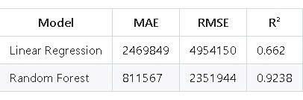
🔹 What factors greatly affect a player's value?
With a dataset like FIFA, which contains many attributes and non-linear relationships, we choose:
🌲 Random Forest Regression
✅ Handles non-linearity
✅ Robust to outliers
✅ Captures complex interactions
To justify this choice, we also build a Linear Regression model in parallel for comparison.
🧠 Goal:
Show why Random Forest is the more reliable and accurate model for predicting value_eur.

Slide 29
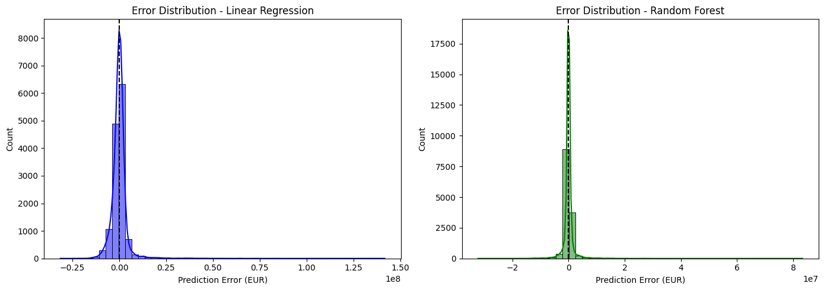
🔹 Modeling Approach: Predicting Player Value
Random Forest outperforms Linear Regression in both accuracy and consistency.
It handles non-linear patterns and outliers much better, making it more suitable for player value prediction.

Slide 30
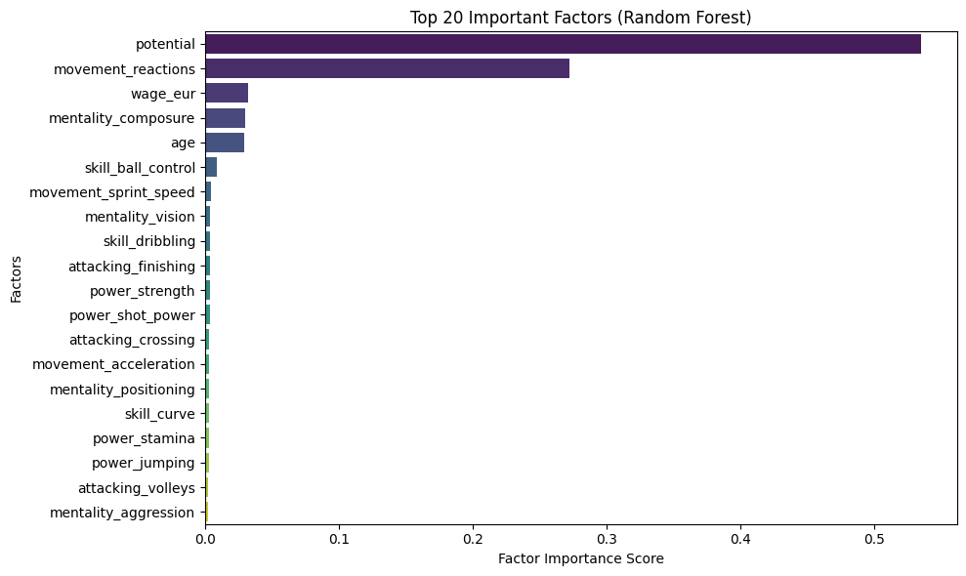
🔹 Feature Importance for Player Value
📊 Key Insights from Top 20 Features
⭐ Potential is the most important factor (>50%): Indicates clubs value future growth over current ability
⚡ Reactions ranks 2nd: Reflects on-field responsiveness
💰 Wage: Financial proxy for player status and role in the squad
🧠 Mentality Composure & Age: Capture maturity, stability, and market perception
🎯 Technical stats (e.g. Sprint Speed, Ball Control): Still relevant but less influential than strategic indicators
📌 Conclusion
Player value is shaped more by potential, consistency, wage, and experience than just technical skills.
Clubs think long-term — focusing on investment value, not just short-term performance.

Slide 31
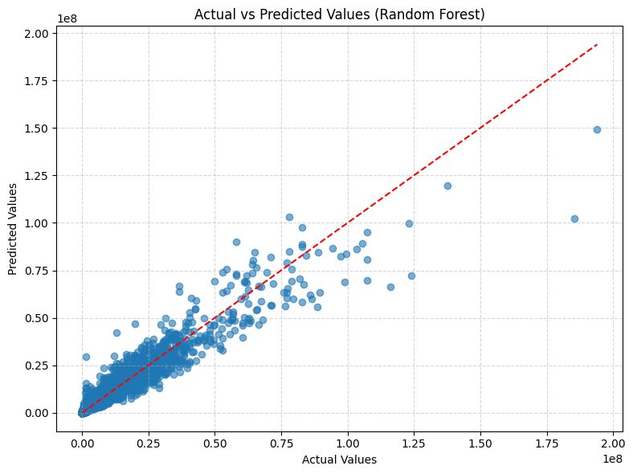
🔹 Is a player overrated or underrated?
📈 RF model is good alignment between predicted and actual values
🔄 Shows that Random Forest captures feature–value relationships effectively. Compared to Linear Regression:
➤ RF handles non-linear patterns much better
➤ Less prone to systematic errors
⚠️ Still slight underestimation at very high values
➤ Likely due to data scarcity or unmodeled factors (e.g., hype, media effect)
✅ Conclusion
Random Forest delivers stable and reliable predictions, with better generalization and error control.

Slide 32
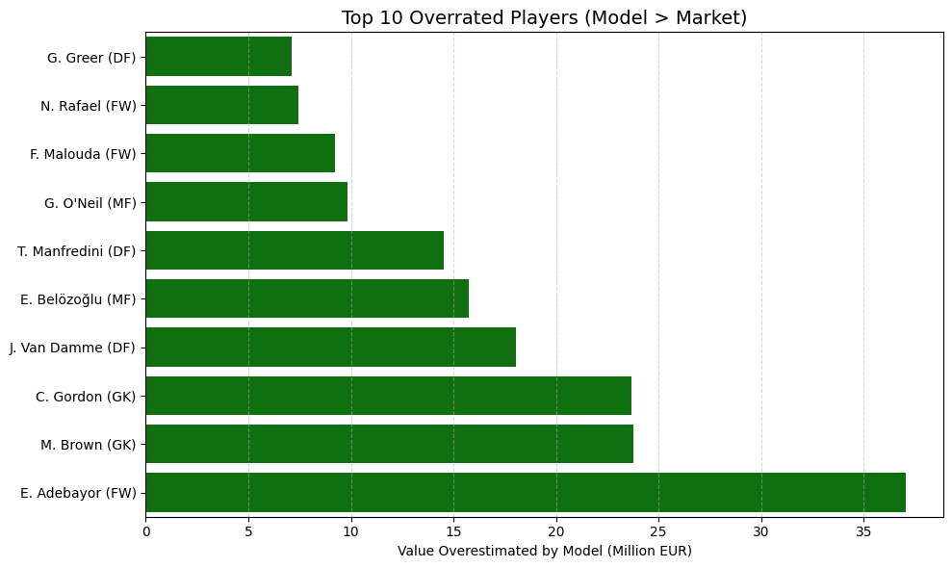
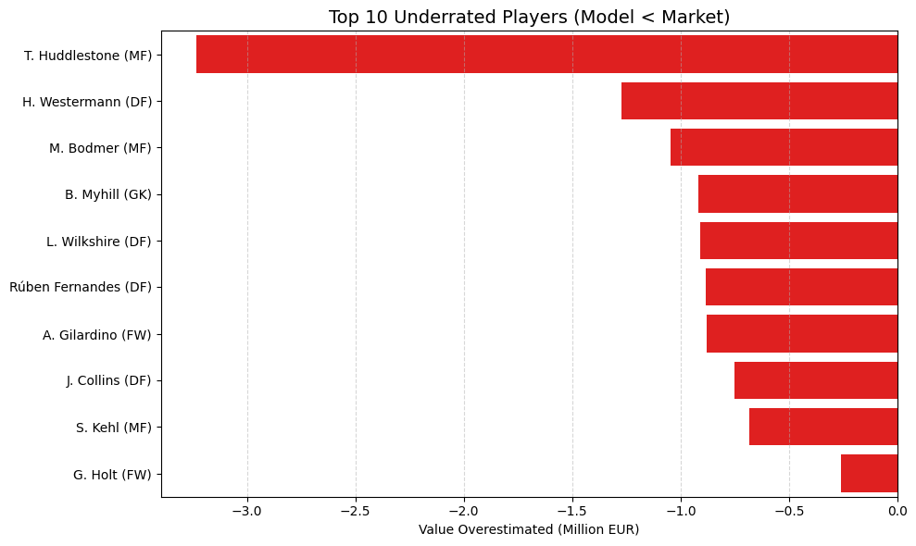
🔹 Overrated & Underrated Players
Overrated: Clubs may overpay – risky signings
Underrated: Smart bargains – hidden gems
Application:
Scout smarter
Negotiate better
Balance performance & price

Slide 33
Recommendations
📌 Actionable Strategies
Integrate Predictive Valuation ➤ Use ML-based value predictions to filter and prioritize targets in scouting.
Build an Underrated Watchlist ➤ Track model-flagged underrated players for smart, long-term investments.
Avoid Overpaying ➤ Compare predicted vs market value to avoid hype-driven pricing.
Strengthen Negotiation ➤ Use model insights as leverage to reduce transfer fees or adjust payment terms.
Hybrid Decision-Making ➤ Combine data + human expertise (e.g. tactical fit, attitude, injury risk) for optimal decisions.
⚽ Final Thought
In modern football, data-driven valuation is no longer a luxury — it’s a strategic necessity.

Slide 34
Conclusion
Modern football requires more versatile players
Tactical & market intelligence = data-driven success
Future = hybrid of analytics + expert judgment Call to Action: Embrace football intelligence

Slide 35
Q&A
🙋‍♂️ "Feel free to ask anything!"
“Thank you for your attention!”

